Slide 1
Iowa Liquor Sales Observations
Baurjan Safi
General Assembly Data Science Immersive

Slide 2
Plan of Presentation
A brief introduction into legal framework of alcohol trade in Iowa
Alcohol Beverages Department and their figures
Analysis of data set and main findings
Main challenges and findings
Iowa and its neighbors

Slide 3
State Monopoly on Liquor Distribution
State of Iowa introduced state control of sales and distribution of alcoholic beverages in 1933
Alcoholic Beverages Department purchases and distributes liquors.
Standard markup is 50%
Revenue in 2016
Liquor Sales $288,908,790
License Fees $ 14,231,744
Beer Tax $ 14,231,744
Wine Tax $ 7,648,753
88 stores closed and 109 new stores opened

Slide 4
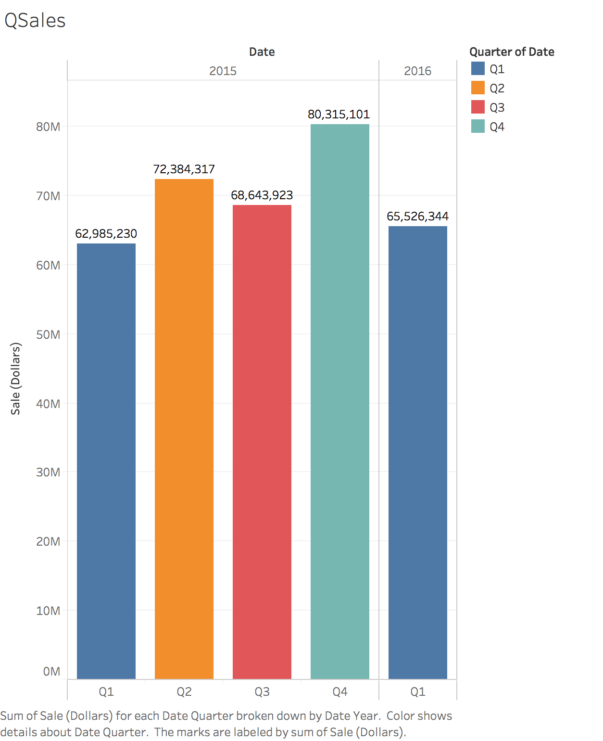
Financial Results, USD Q-to-Q

Slide 5
Fact and Forecast for 2016 if other things remain unchanged

Slide 6
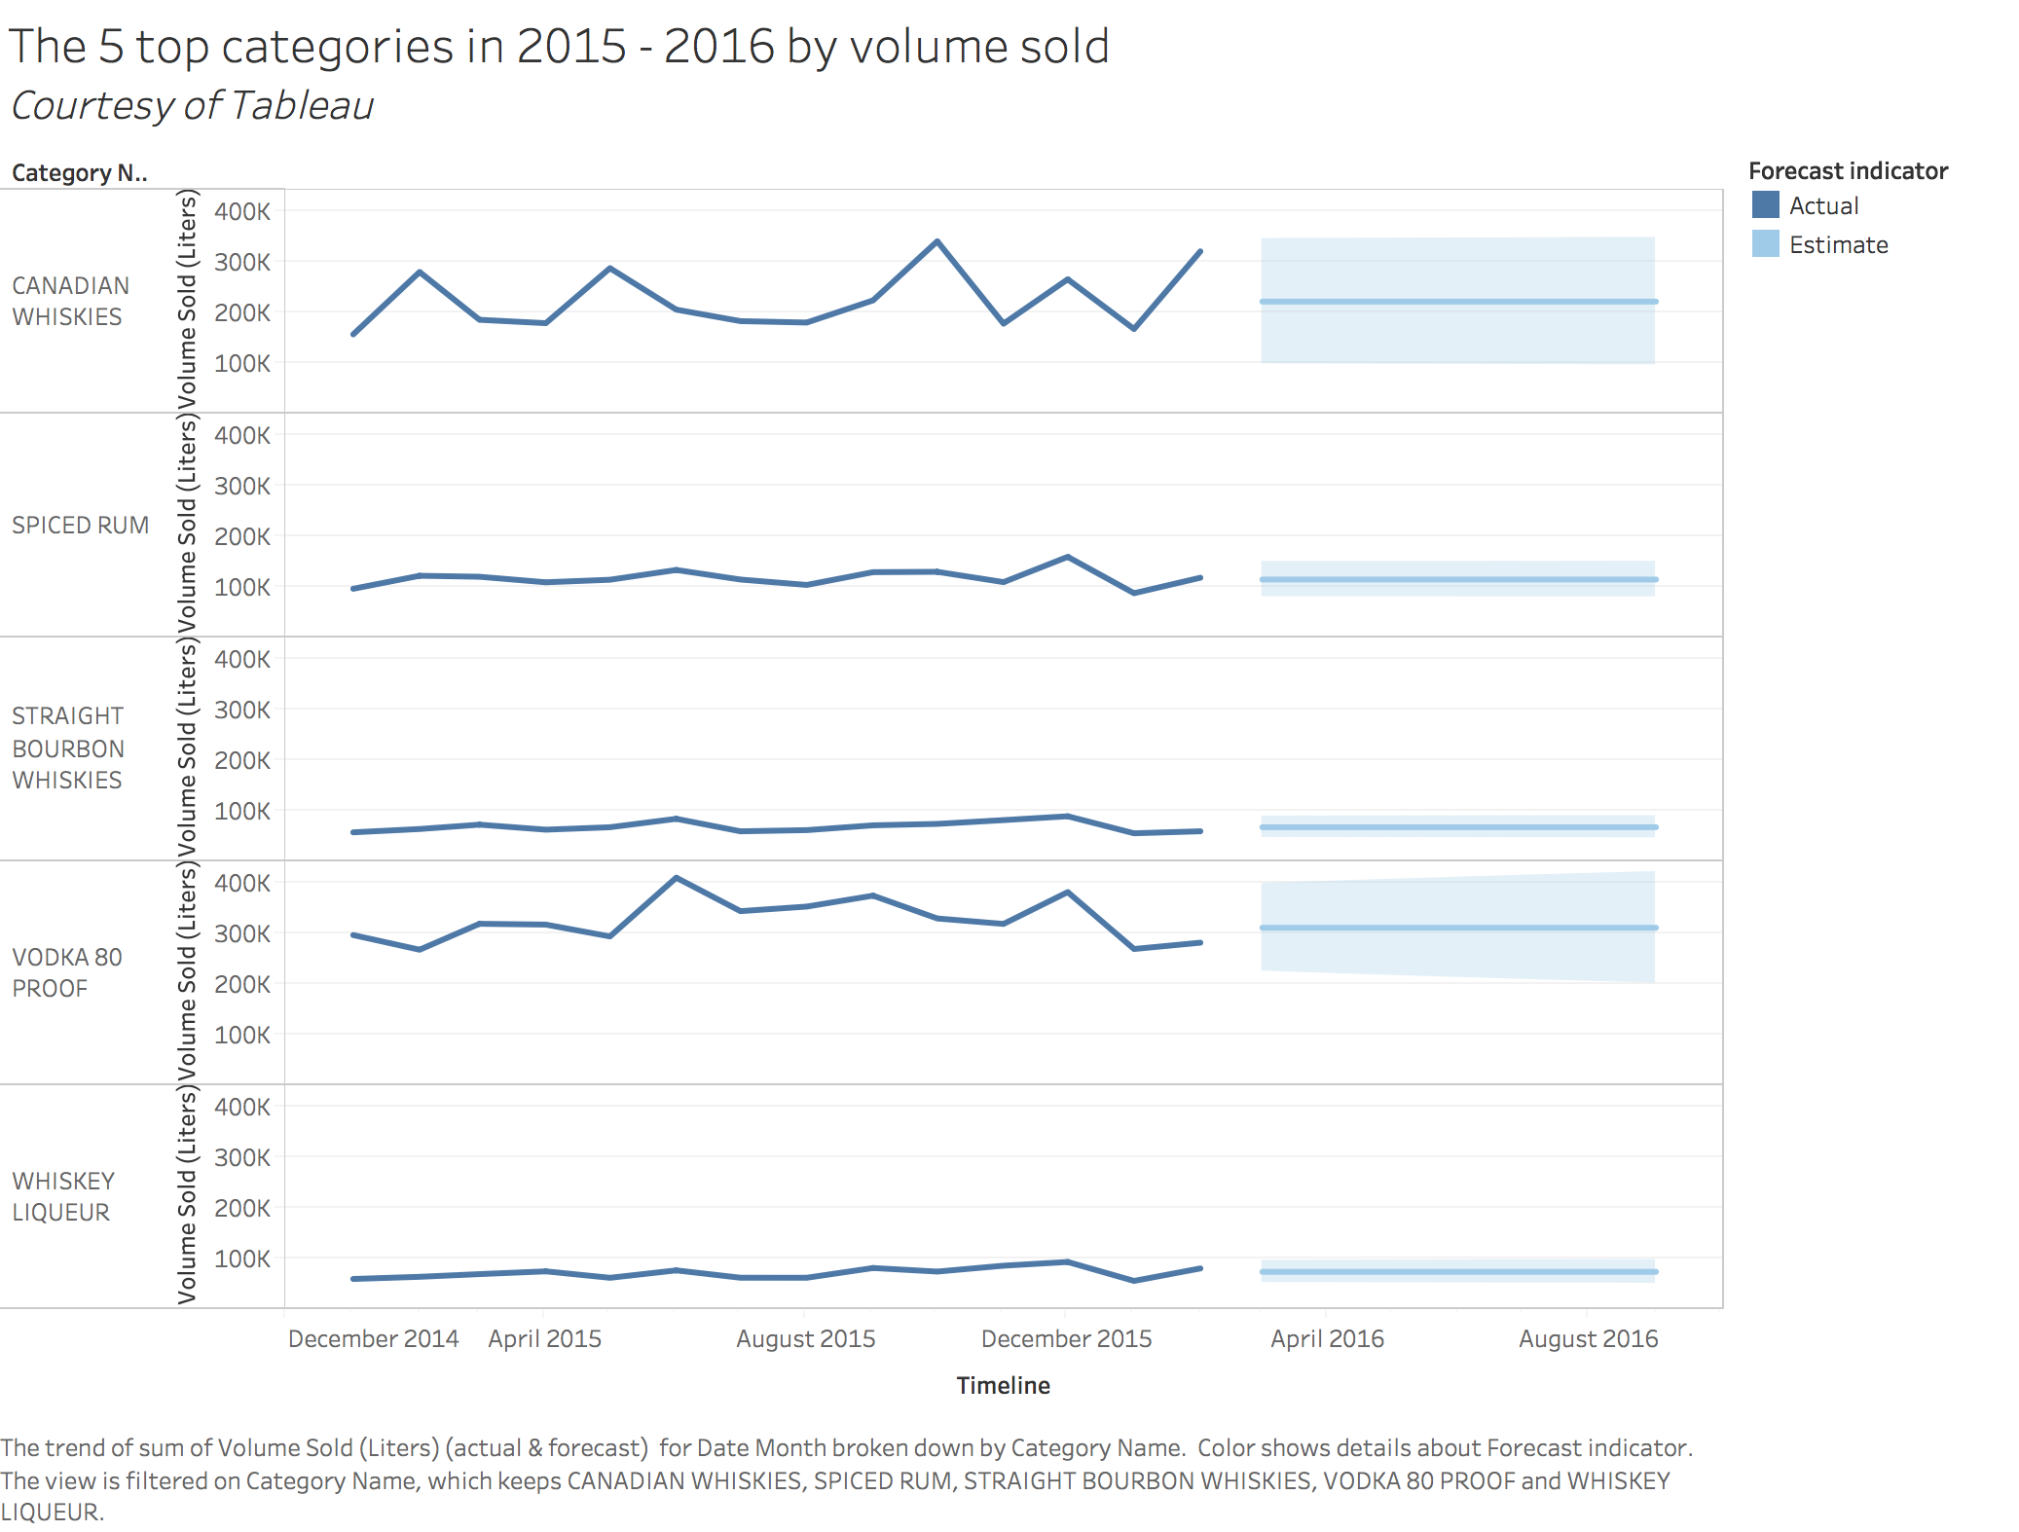
Top 5 Drink in IOWA

Slide 7
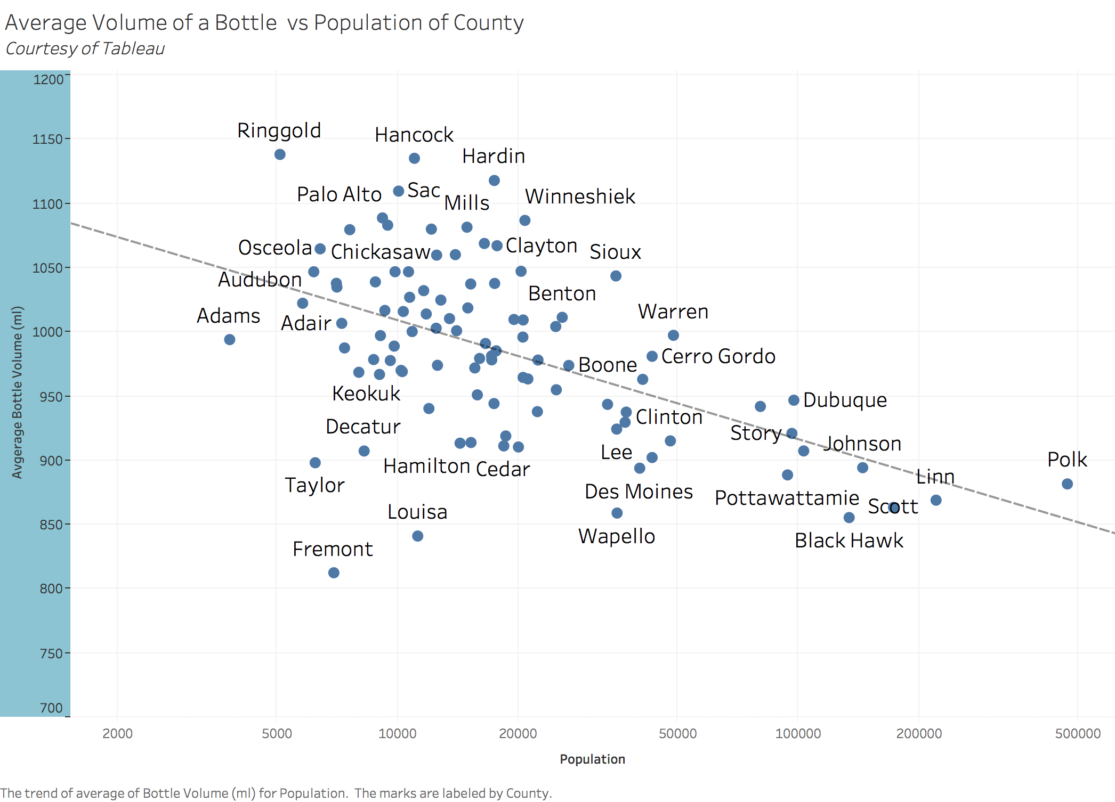
The Large Counties Drink from Smaller Bottles

Slide 8
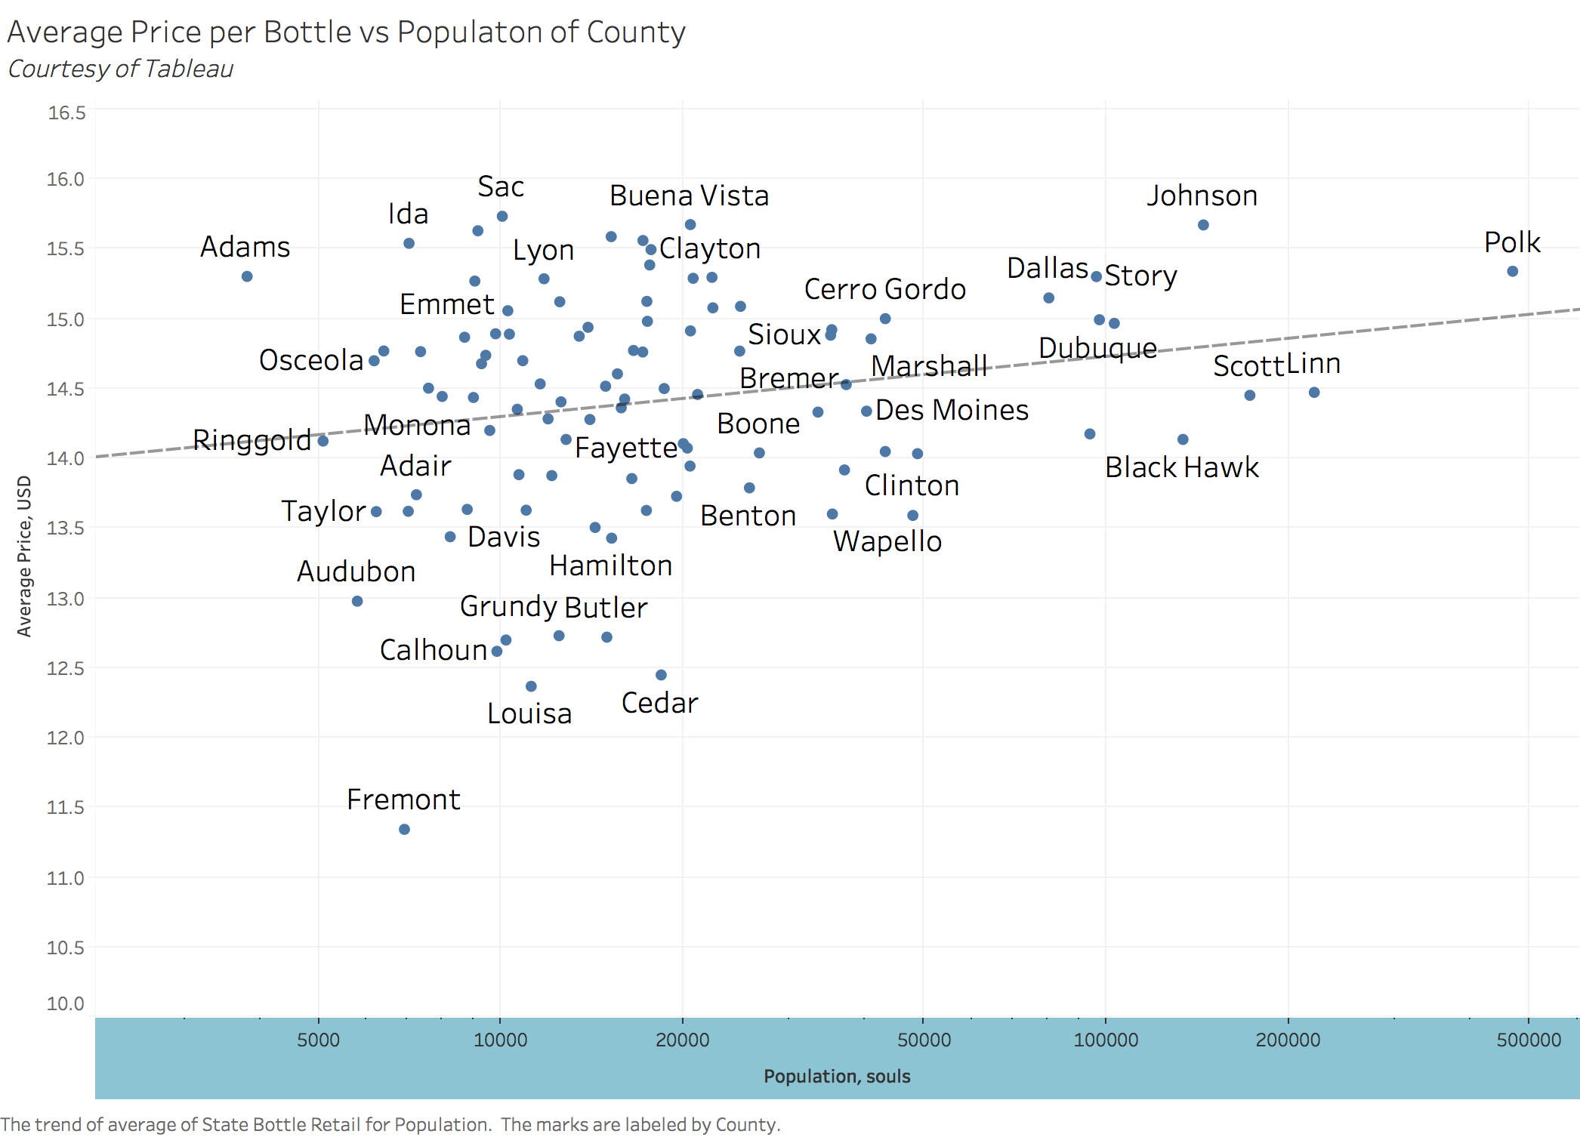
Small Counties Pay Less

Slide 9
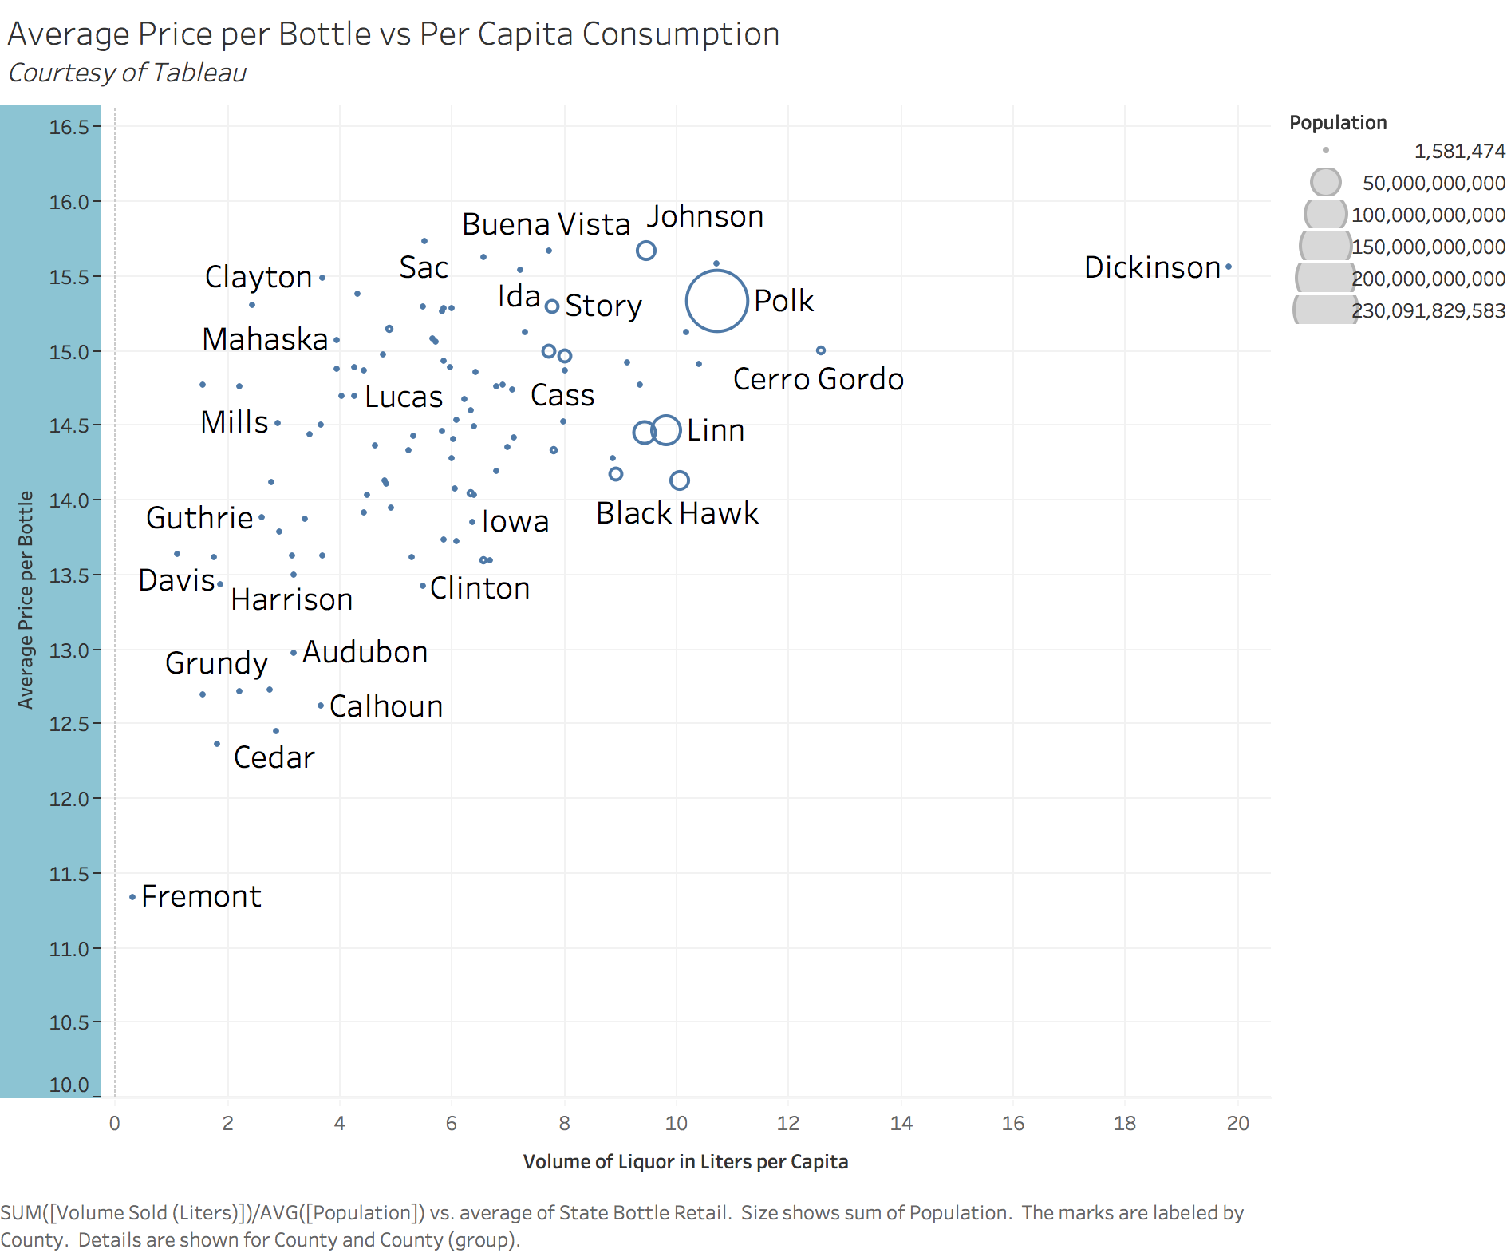
Guess the Name of the Lake in Dickinson County?

Slide 10
Challenges
How do we increase revenue?
How do we decrease consumption of alcoholic beverages?
How do we compare to other states around?
WE ARE SQUIZZED ON ALL SIDES!!!

